Slide 1
Linux Bash Code Generation
Josh Shih, Kevin Um, Qianyi Sha

Slide 2



Team
Kevin Um, ECE PMP
Josh Shih, ECE PMP
Qianyi Sha, ECE PMP

Slide 3
Recap

Slide 4
Idea Recap - Linux Bash Code Generation
Purpose: To generate bash commands from text input, help people learn to use linux bash.
Notes:
https://github.com/TellinaTool/nl2bash/tree/master/data
Difficulties:
structural generation
evaluation

Slide 5
Why is the project interesting/challenging/impactful?
Proof of concept using transfer learning to fine-tune a language model and make it produce structured code instead of natural language.

Slide 6
Recap - Mid Quarter presentation
Scope
Approach
Challenges
Encountered Problems

Slide 7
Scope
Accurately generate the entire bash command line for 25 of the most common bash commands from english natural language input.
List of commands:
ping, SSH, apt-get, cat, cd, chmod, clear, cp, dir, echo, env, free, get, kill, ls, mkdir, mktemp, mv, put, pwd, rm, stat, top, touch, tree, rmdir

Slide 8
Approach
Create/Gather quality datasets
Experiment/pick best seq2seq transformer to finetune.
Use new tokenization technique for preprocessing
Sequential Training on different datasets.
Use new evaluation metric to evaluate

Slide 9
Key Challenges
Choosing the most suitable transformer to finetune
Dataset
Structural output (bash cmds)
New tokenizer for bash cmds
New evaluation method

Slide 10
Major Problems left off from last time
Dataset
Class Imbalance from NL2BASH dataset
Lack of data diversity
Structural output (bash cmds)
Constraint Decoding
Change to classification problem from command portion of bash cmd
New tokenizer for bash cmds
New evaluation metric

Slide 11
New Progress

Slide 12
Dataset 1 - NL2Bash
How did we solve class imbalance?
Defined maximum threshold of 1000
Removed user input/command pairs > 1000 reps
Calculated # of repetitions for each command
Calculated delta (highest - lowest)
Used text-davinci-002 to generate delta of user input/command pair

Slide 13
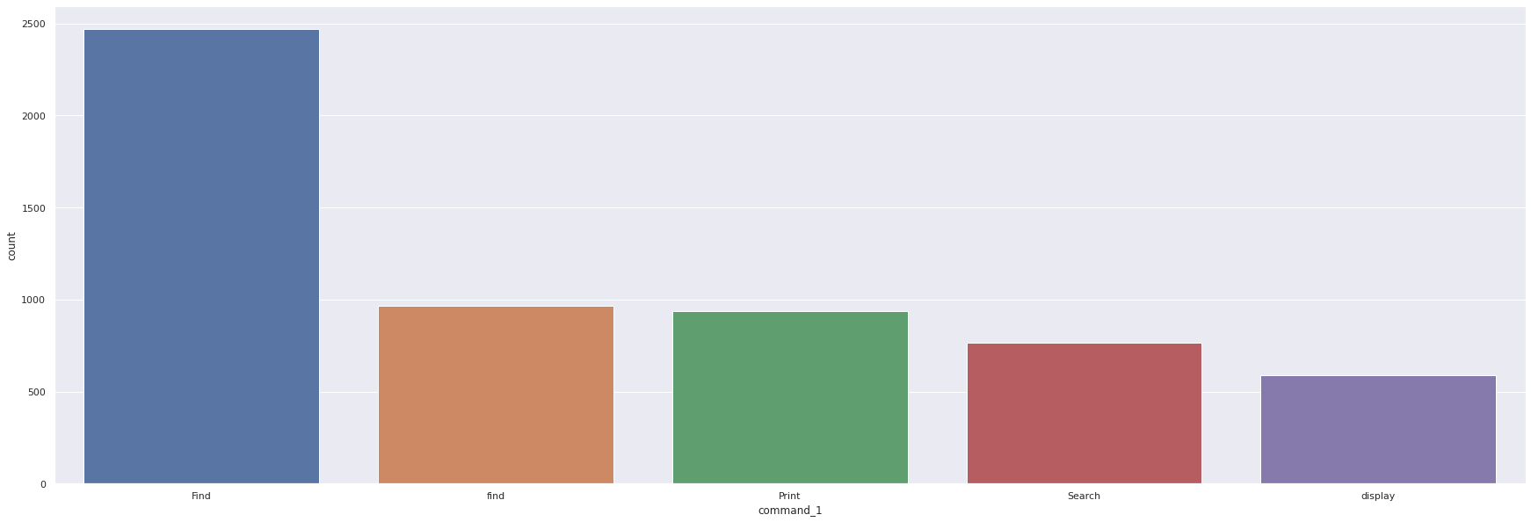
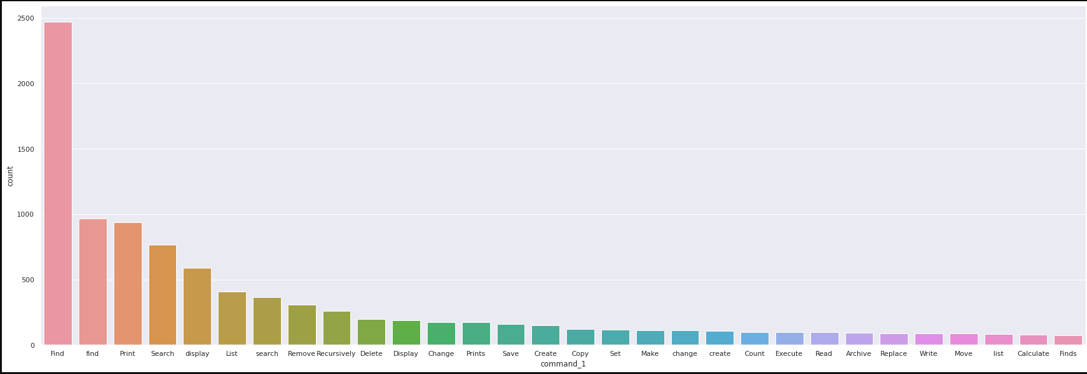
Dataset 1 – Original NL2Bash

Slide 14
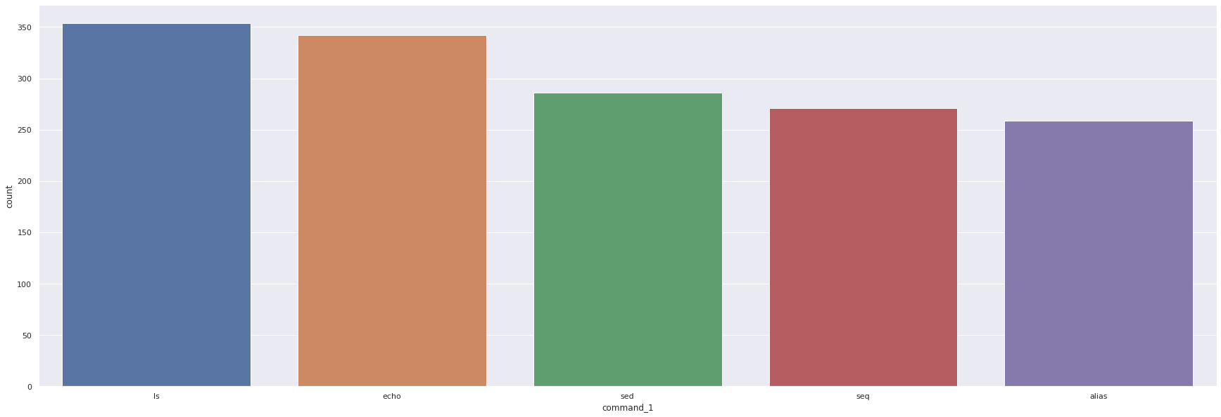
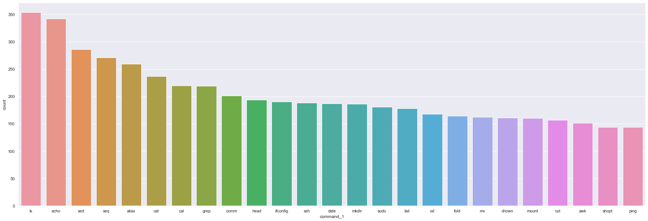
Dataset 1 – Balanced NL2Bash

Slide 15
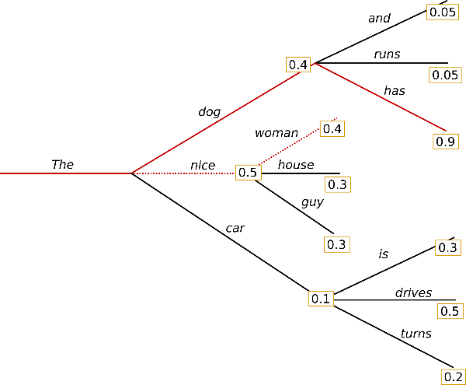
Constrained Decoding with Constrained Beam Search
Greedy Search
Selects word with highest probability as next word
Beam Search
Reduces risk of hidden high probability words, keeps num_beams hypothesis
Constrained Beam Search
Conduct training with a single or list of ‘output’ words
Inject respective tokens at each step of generation
Source: How to generate text: using different decoding methods for language generation with Transformers (huggingface.co), Guiding Text Generation with Constrained Beam Search in 🤗 Transformers (huggingface.co)

Slide 16
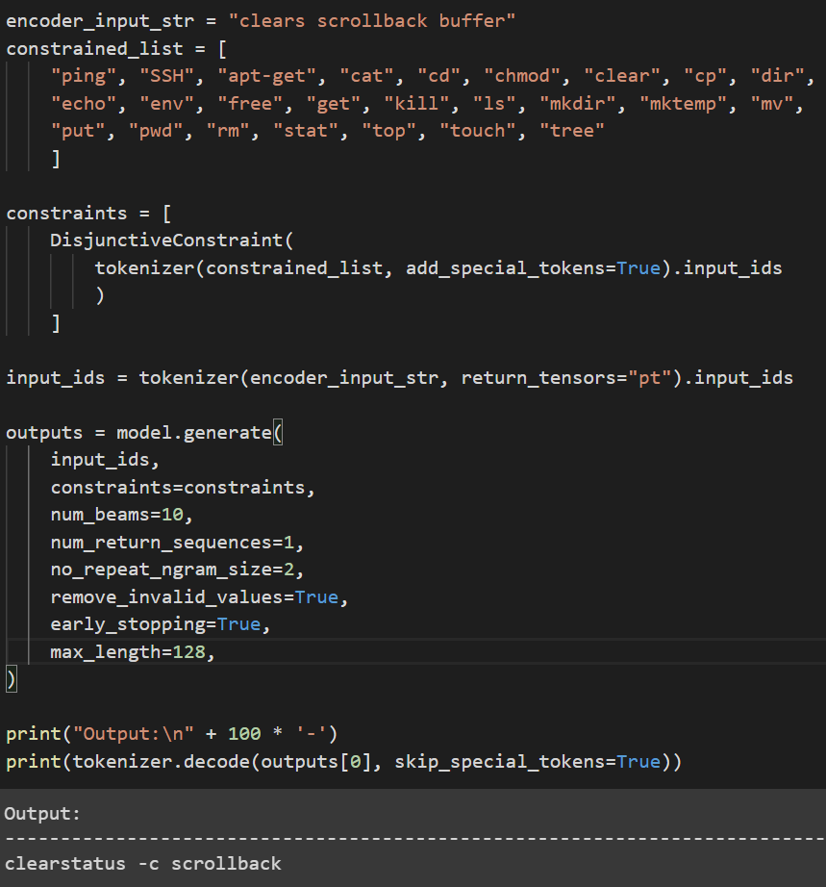
Constrained Decoding with Constrained Beam Search
Disjunctive Constraints
Equal possibility of being used given list of ‘output’ words
Guide generation to contain at least one among list
List of ‘output’ words: commands from customv3 (smaller training dataset)
Pretrained weights from t5-large using NL2BASH dataset

Slide 17
Constrained Decoding with Constrained Beam Search
Performance Comparison
User input:
“Clears scrollback buffer”
Ground truth:
clear -x
Sequential Model:
clear -x, 1.0
T5-Large (NL2BASH):
clear scrollback, 0.65
Constrained Decoding:
clearstatus -c scrollback, 0.0

Slide 18
Dataset 2 GPT-3.5-Turbo generated data
Custom-V1 -> ChatGPT enriched
Manually generated
Custom-V2 -> GPT3
Text complete Model
Custom-V3 -> GPT-3.5-Turbo
Conversation Model

Slide 19
Problems encountered
Enrichment doesn’t work that well
How to pass the instructions.
Chat based model vs Sentence complete model
Outputting structured data.
Data cleaning.
Comparing different models
Limited by model.

Slide 20
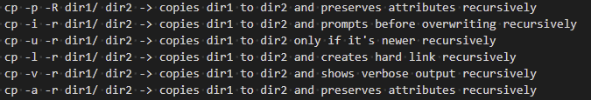
Result

Slide 21
Evaluation Metric
Measure how similar our output is to the closest correct bash command on a scale of 0.0 - 1.0

Slide 22
Evaluation Metric
Structure of General Bash Command:
command [-flag(s)/-option(s)] [argument(s)]
Command > Argument(s) > flag(s)/option(s)
Split each bash command to three types Cmd, Arg, Opt and give an adjustable weight to each token.

Slide 23
Evaluation Metric
Break down output/ref cmds to unigrams(individual words)
Group unigrams into 3 categories [Cmds], [Args], [Opt]
For each category, count number of n-grams in output cmd that appear in reference cmd.
Divide this by total number of n-grams in ref cmd.
Multiple this by predefined weights for each category [Cmds], [Args], [Opt] and add them together.

Slide 24
Metrics available on hugging face:
import evaluate
metric=evaluate.load("Josh98/nl2bash_m")
Evaluation Metric
Ground Truth:
grep -v -o test12.html "www.example.com"
Example Output:
grep -v -s test.html "www.example.com"
Tokenize:
Command
1 x 0.65
Option
0.5 x 0.15
Argument
0.5 x 0.2
Weights:
N2LBash Score:
= 0.65 + 0.075 + 0.1 = 0.825

Slide 25
Results and Analysis

Slide 26
Evaluating Model Performance
 | T5-Small - NL2bash | T5-Small - NL2bash + V3 | T5-Large - NL2bash | T5-Large - NL2bash + V3
NL2Bash_metric | 0.619 | 0.695 | 0.782 | 0.882

Slide 27
Example Outputs on eval set
Input | Ground Truth | T5-Small - NL2bash (0.619) | T5-Small - NL2bash + V3 (0.695) | T5-Large - NL2bash (0.782) | T5-Large - NL2bash + V3 (0.882)
Give the owner read and execute permissions, and others read-only permissions to directory/. | chmod 554 directory/ | chmod -a ls -p dirname/ | chmod 800 directory/ | chmod u+rx,g+r directory | chmod 544 directory/
Writes the text "Hello World" and saves it in a file called foobar.txt. | echo "Hello World" > foobar.txt | grep -v "Hello World" foobar.txt | echo "Hello World" > foobar.txt | echo Hello World | tee foobar.txt | echo "Hello World" > foobar.txt
Start a clean environment | env -i /bin/bash | mkdir -p | env -i ______ | env -C | env -i /bin/bash
Creates a new temporary file with file prefix in the /tmp/ directory. | mktemp -p /tmp/ file | mktemp -p /tmp/ ___ | mktemp -p /tmp/ -p file.tx | mktemp -t | mktemp -p /tmp/ file

Slide 28
Future improvements
Enrich the descriptions
Progress was made but effect is not great
Data cleaning difficulties
Generating repeated data may induce bad results
Change to classification problem from command portion of bash cmd
Weighted Cross entropy loss (More loss on cmd portion)
T5-Small - NL2bash kevinum/t5-small-finetuned-English-to-BASH | T5-Small - NL2bash + V3 alexsha/t5-small-finetuned-NL2BASH-customv3 | T5-Large - NL2bash alexsha/t5-large-finetuned-English-to-BASH | T5-Large - NL2bash + V3 alexsha/t5-large-finetuned-NL2BASH-customv3

Slide 29
Thank you!

